Slide 1
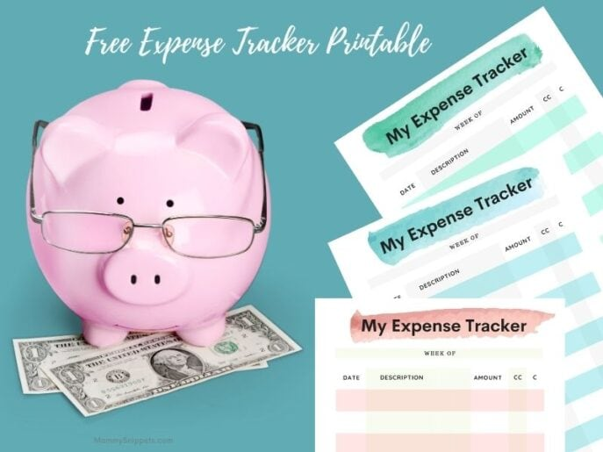
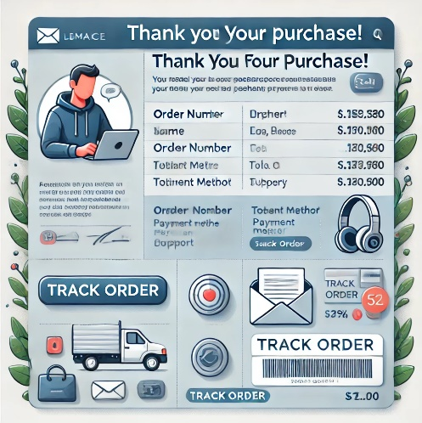
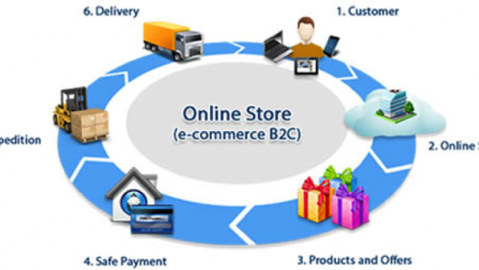
STREAMLINING PERSONAL FINANCE
AN INTEGERATED SYSTEMS FOR AUTOMATED TRANSACTION ENTRY
Haryish E | MCA
Reg. no.: 67222200076 | Roll No.: 2232MCA0058
CDE | Anna University

Slide 2
GRATITUDE
Dr. P. Nirmal Kumar Professor and Additional Director, Centre for Distance Education, Anna University, Chennai
For his constant motivation throughout the course.
Dr. S. Bose, Professor, Department of Computer Science and Engineering, CEG Campus, Anna University, Chennai
For his guidance, supervision, and valuable insights during the project.
Dr. S. Pradeep, Assistant Professor, Centre for Distance Education, Anna University, Chennai
For his moral support and encouragement.

Slide 3
AGENDA
Introduction
Product overview
Project Objective
System Requirements
Functional Requirement
External Interfaces
System Architecture
System Design
Functional Architecture
Components Overview
Implementation and Testing
End Results
Accomplishments
Challenges
Future Work
Summary

Slide 4

Introduction
Intended Audience: Small Business / Freelancers and Individuals
Scope: Streamlining financial management on expense tracker and visualization based on the same.
Implemented Technical concepts:
Full Stack web application
Data Visualization
SMTP
Networking
The Aim of the project is to emphasize technically on the approach of how transactions by the users are being synced to expense tracker.

Slide 5

PRODUCT OVERVIEW
What is Expense Tracker?
A Django-based web application that helps individuals and freelancers manage and track their finances.
Provides insights into income and expenses through data visualization.
Purpose of the Project:
Streamline financial management for users.
Ensure better control and analysis of personal and professional transactions.

Slide 6
Comparison overview (Based on literature)
Criteria | Traditional Methods | Existing Systems | Proposed System
Automation Level | Manual entry | Semi-automated | Fully automated
Data Security | Low | Medium | High
User Interface | Complex | Moderate | User-friendly
Integration Capabilities | None | Limited | Extensive
Cost | Low | Medium | High
Scalability | Low | Medium | High
User Support | None | Basic | Comprehensive
Data Accuracy | Prone to errors | Improved but inconsistent | High accuracy with automation
Time Efficiency | Time-consuming | Moderate | Highly efficient
Visualization Tools | None | Basic charts focusing on categories of transaction | Advanced visualizations (e.g., pie charts, bar graphs)
Transaction Categorization | Manual | Limited automation | Automated with NLP and templates (not in current scope)

Slide 7

PRODUCT OBJECTIVE
To build a user-friendly expense tracking system.
To provide manual tagging for transaction categorization.
To enable data export for external analysis.
Future enhancements include live API integrations and Segregation of txn data.

Slide 8
SYSTEM REQUIREMENTS

Slide 9

FUNCTIONAL REQUIREMENTS
Client Environment
Browser Compatibility: Supports modern browsers like Chrome, Firefox, Edge, and Safari.
Device Compatibility: Best experienced on desktops and laptops.
Network Requirement: Stable internet required for real-time synchronization.
Server Environment
Hosting Platform: Deployable on cloud platforms (AWS, Heroku, Azure) or local servers.
Backend Framework: Built using Python Django for scalability and robustness.
Database: SQLite for storing and managing transactions and user data.

Slide 10
External Interfaces
Hardware |  | Software |  | Communication
Interface | Component | Interface | Component | Interface | Purpose
Devices | Laptop or Desktop | Front End | HTML, CSS, JS (Node.JS), PyQT (for Mock Ecom Application) | Protocols | HTTP/HTTPS Ensures secure data transfer
Connectivity | Requires stable internet | Backend | Python Django | Mocked APIs | Email extraction Transaction processing
 |  | Databases | PostGreSQL / SQLite
 |  | API | REST API

Slide 11
SYSTEM ARCHITECTURE

Slide 12
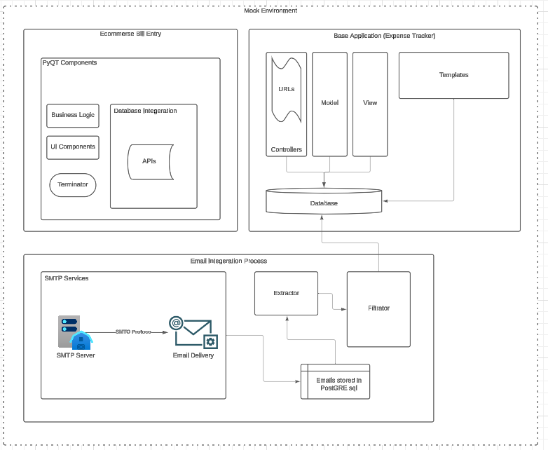
Architecture
External Components
1. Base Application: (Expense tracking system)
Uses MVC approach on Python Django
Database uses Postgre SQL
2. Online Ecommerce Transaction Interface
Uses PyQT for user interface
Integrated with REST API for parsing Email
3. Email Extraction and data parsing systems:
Follows Mocked SMTP protocol
Data Extraction uses Regex Module

Slide 13
SYSTEM DESIGN

Slide 14
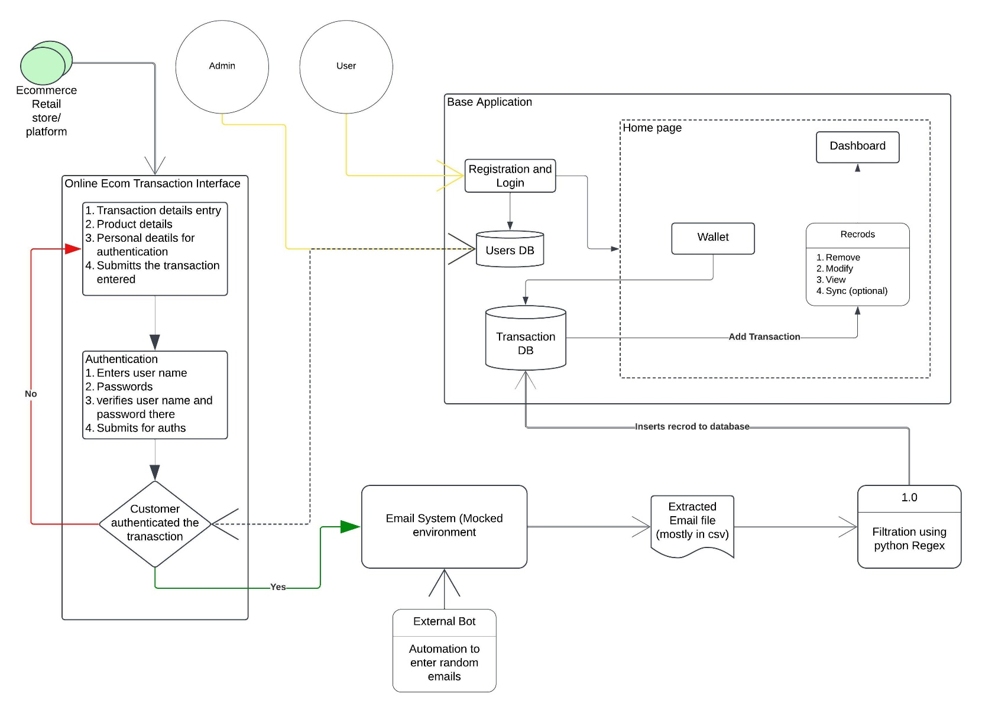
FUNCTIONAL ARCHITECURE

Slide 15
COMPONENTS OVERVIEW
The architecture is divided into three major components that interact seamlessly to streamline financial management
Expense Tracker
Ecommerce billing interface
Email Integration and Data segmenting.
Expense Tracker (Base System)
Ecommerce Interface
Mocked External System for capturing instore and online shopping transaction details.
Email integration
Automates email parsing to extract relevant transaction details to actionable data.
Core Module for managing transactions, visualizations and user interactions
Notes:
Core module for managing transactions, visualizations, and user interactions.
Mocked external system for capturing in-store and online shopping transaction details.
Automates email parsing to extract relevant transaction details into actionable data.

Slide 16
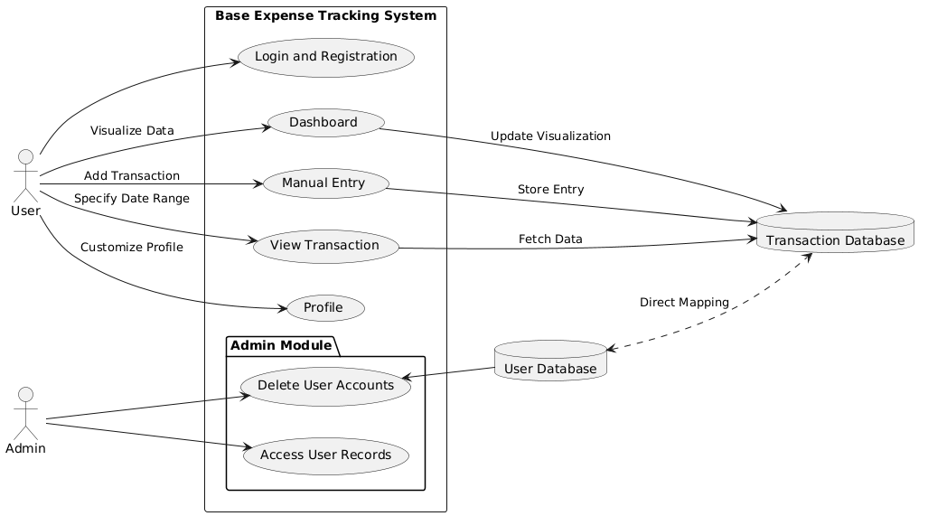
Expense Tracker – Base application
Key Features:
User interaction with transaction lists, dashboard visualizations, and manual transaction entry.
Acts as the base for automating transactions.
Components:
Login and Registration: Basic credential-based user authentication.
Home Page Features:
Dashboard:
Data visualization (Pie Chart: Daily/Weekly expenses; Bar Graph: Monthly budget trends).
Manual Entry: Direct database storage of user-entered transactions.
View Transaction: Tabular transaction view for a user-specified date range.
Profile: User profile customization.

Slide 17
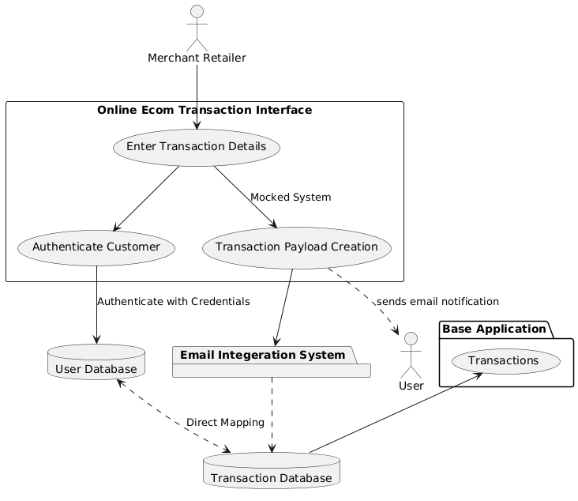
MERCHANT (E-commerce) Transaction Interface
Functionality
Mocked system for entering transaction details (manual or payload for online shopping).
Customer authentication via username and password.
Developed Interface:
It is Built in PyQT module that is package from Python for User Interface targeting for developing simple desktop applications.
Inputs required:
Type (Expense or Expense Refund), Item, Category, Amount, Date
Output
Payload of POST request having the inputs above.
Future Scope
Real-time Integration (say interface where the it processing the payment online / instore billing softwares) may replace mocked system.
Notes:
Functionality:
Mocked system for entering transaction details (manual or payload for online shopping).
Customer authentication via username and password.
Future Scope:
Real-time integration may replace the mocked system.

Slide 18
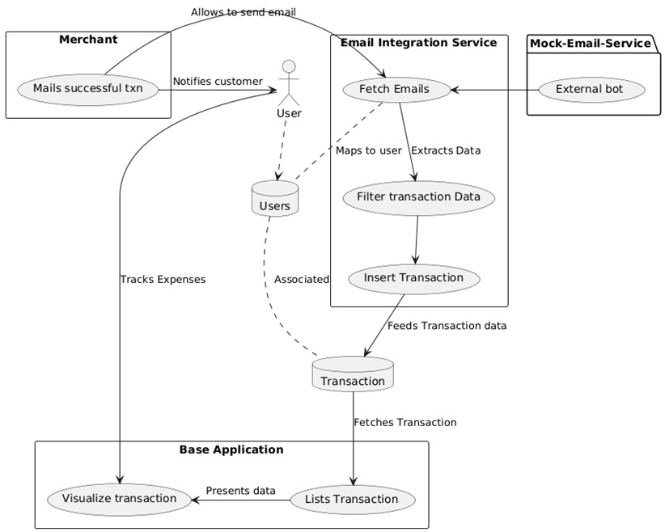
EMAIL Integration System
Components:
Emailing System;
Mocked email sending via an External Bot – Mostly it is API
Automates Email Processing for Filtering
Extraction Process
The sent email are parses to excel with separate users and extracted for filtration
Filtration
Regex filters keywords like banker name, merchant, debit/credit, amount, etc.
Converts email content into tuples for database used
Significance:
Automates the transformation of email data for streamlined processing.
Future Scope
The email Extraction utilizing Gmail API, was not included in scope due to cost.
Notes:
Key Components:
Emailing System:
Mocked email sending/visualization via an email bot.
Automates email processing for filtering.
Extraction Process:
Python methods extract emails into a CSV file.
Filtration:
Regex filters keywords like banker name, merchant, debit/credit, amount, etc.
Converts email content into tuples for database use.
Significance:
Automates the transformation of email data for streamlined processing.

Slide 19
IMPLEMENTATION AND TESTING

Slide 20
FEATURE OVERVIEW
User Authentication
Handles user registration, login, and profile management.
Utilizes Django's built-in User model and form validation
Expense Management
Allows users to record, categorize, and view financial transactions.
Transactions include details like amount, category, date, and user.
Analytics
Provides data visualizations (e.g., pie charts, bar graphs) for spending analysis.
Developed using libraries like matplotlib, pandas.
Export Data:
CSV file downloads for filtration
Admin Interface: Customizations to manage user profiles and transactions effectively.
Routing: Modular URL mapping through app-specific and project-wide urls.py.
Functional Highlights:
CSV export of transactions.
Secure user authentication.
Responsive and interactive data visualizations.

Slide 21
Database Overview and Entity Definitions
The database employs normalization principles to eliminate redundancy and ensure data integrity. It is structured to handle user information, financial transactions, and user profiles effectively.
Normalized schema for reduced redundancy and ensured data integrity.
Supports user information, financial transactions, and user profiles.
Auth_user
Stores authentication details
Home_userprofile
Extends user data
Links auth_user via user_id
Home_addmoney_info
Logs expenses (amount, categories, dates)
Links with auth_user via user_id
Home_addmoney_gains
Logs Incomes / Gains via transaction
Similar to home_addmoney_info

Slide 22
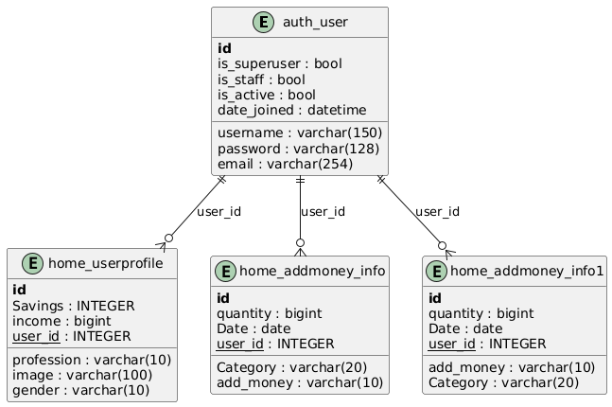
Schema Details and Design Considerations
Relation entities: Users, Transactions, and Merchants.
It ensures data normalization and provides a clear blueprint for database schema implementation
Design Considerations:
Normalization: Eliminates redundancy.
Scalability: Supports future enhancements (e.g., new transaction types).
Integrity: Foreign key constraints ensure relational consistency.
Outcome: A scalable and robust database ensuring seamless data management.
Notes:
Title: Schema Details and Design Features
Key Tables:
auth_user
Primary Key: id
Key Fields: username, password, email, date_joined.
home_userprofile
Primary Key: id
Key Fields: profession, income, gender, user_id.
home_addmoney_info
Primary Key: id
Key Fields: date, category, add_money, user_id.

Slide 23
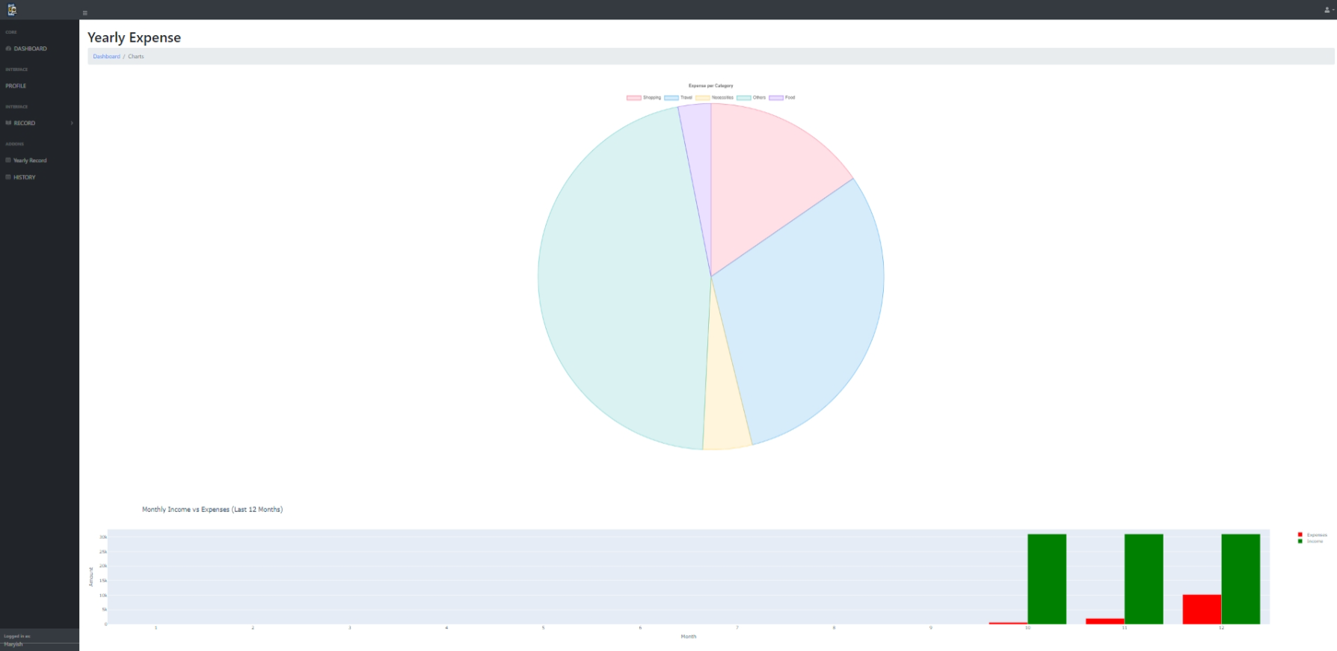
DASHBOARD – for Visualization
Provides a financial overview.
Displays income and expense summaries.
Offers data visualization through interactive graphs.

Slide 24
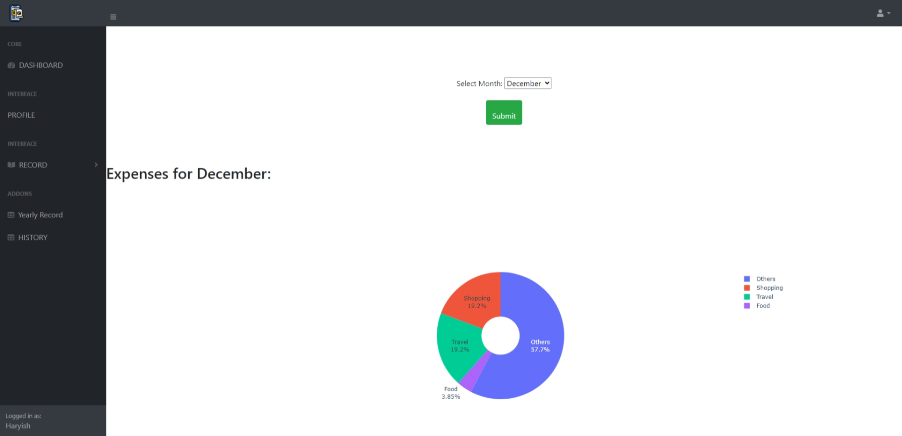
DASHBOARD – for Visualization
Provides a financial overview.
Displays income and expense summaries.
Offers data visualization through interactive graphs.

Slide 25
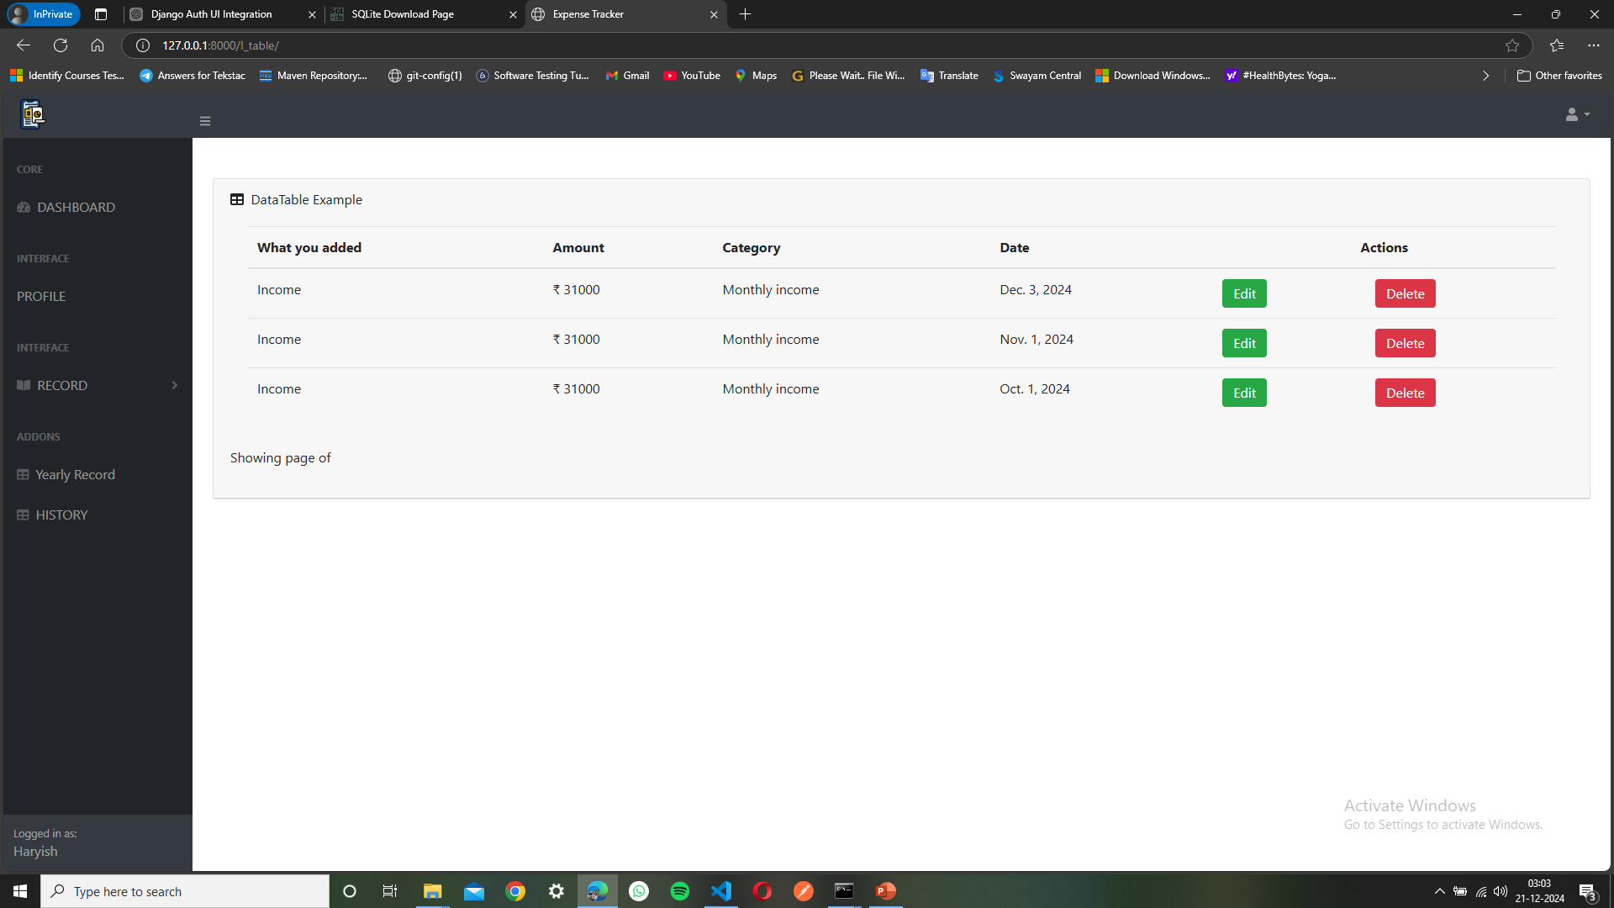
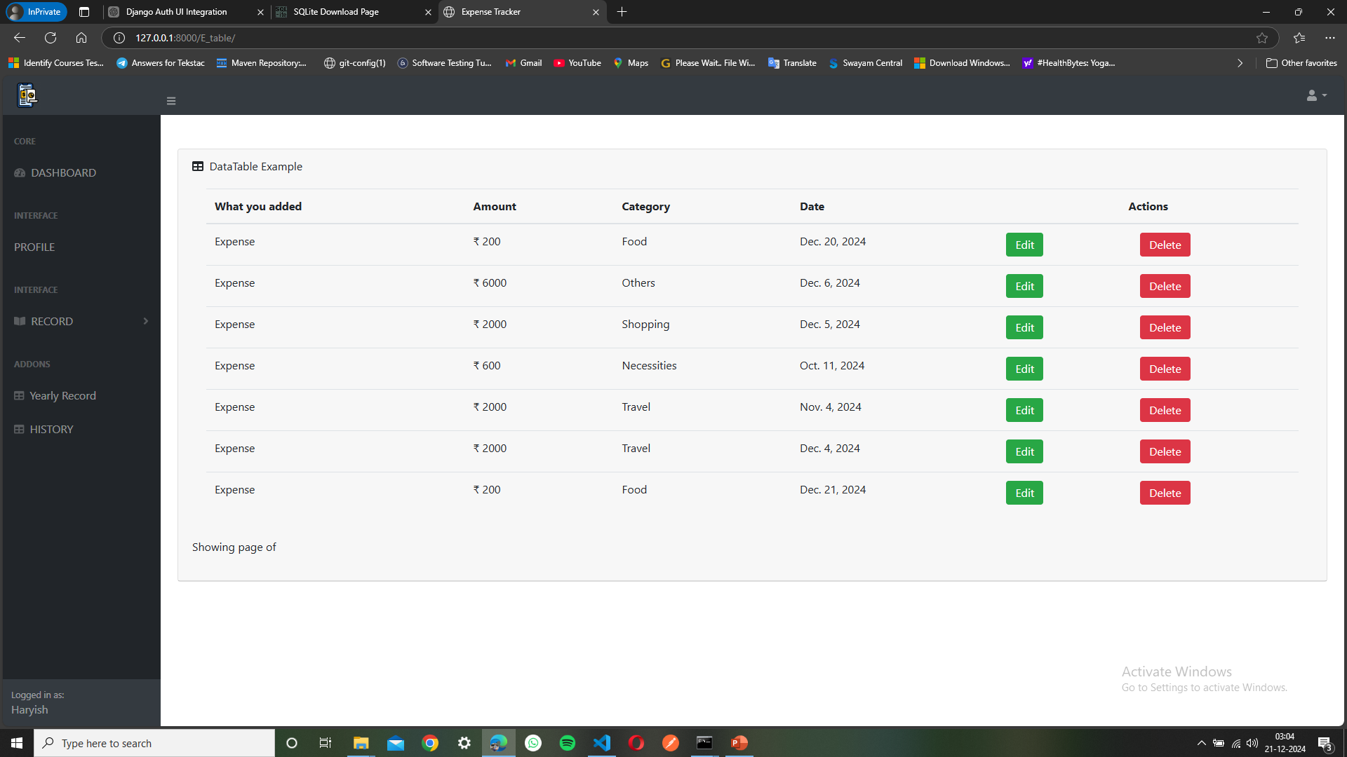
EXPENCE AND GAINS TABLE

Slide 26
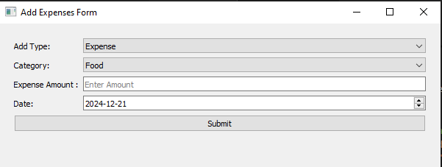
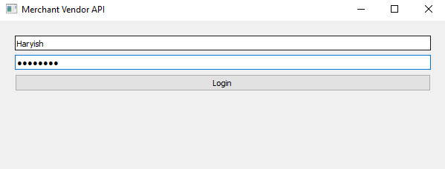
EcommerCe (MERCHANT) BILLING INTERFACE

Slide 27
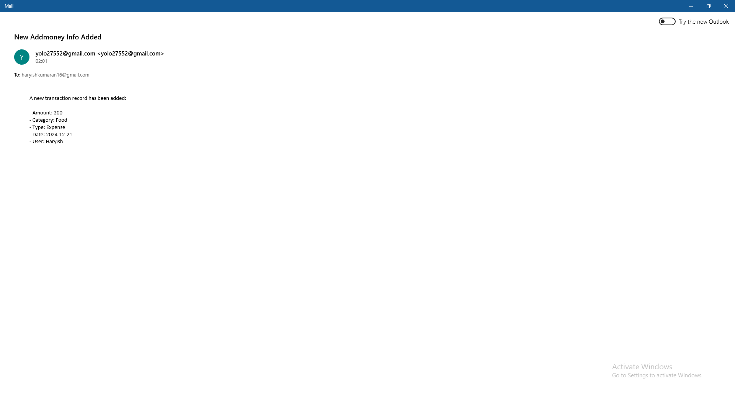
EMAIL INTEGRATION- Email received and EXTRACTION
Provides a financial overview.
Displays income and expense summaries.
Offers data visualization through interactive graphs.

Slide 28
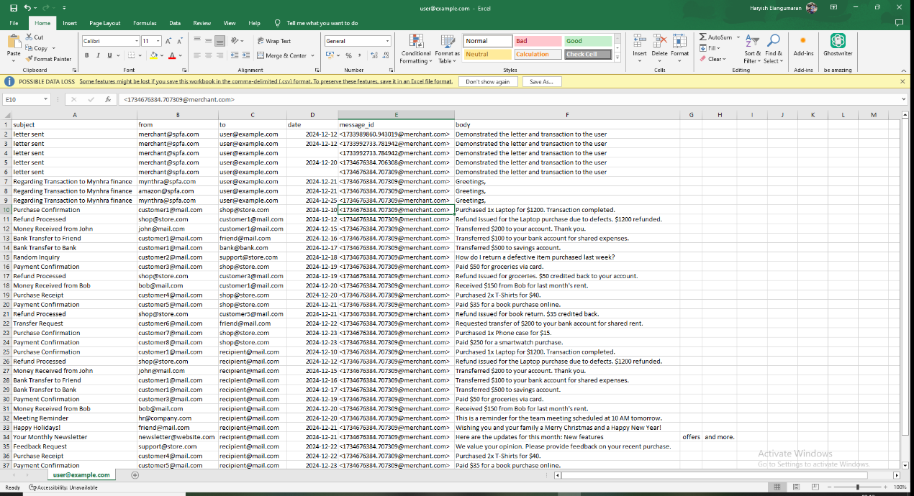
Dataset
These sample data are used for extraction and filtration to the tuple
These tuples are then sent to database integ. with Django application for display.

Slide 29
CONCLUSION

Slide 30
Accomplishments
Built the initial user interface that can provide API payload of transaction with authentication
Proposed common approach on how automated expenses are tracked
Utilized Regex, NumPy an Pandas for classification and segregation.
Handling shorter datasets for visualization.
Implementing mock APIs for email and transaction synchronization.
Users / Testers can provide their beta and smoke test

Slide 31
CHALLENGES
Mock APIs for:
Email synchronization.
E-commerce transaction simulation.
No real-time external API integrations in the current scope.
Handling large datasets for visualization.
Implementing mock APIs for email and transaction synchronization.
Ensuring seamless user experience across all roles.

Slide 32

FUTURE SCOPE
Integration with real-time APIs for:
Bank account synchronization.
Email transaction parsing.
ML-based automatic tagging for transactions.
Improved performance on low-resource servers.

Slide 33
CONCLUSION
The Expense Tracker simplifies financial management for individuals and freelancers.
Successfully implements mock APIs and Django framework capabilities.
Future-ready with planned API integrations and ML features.

Slide 34



Thank you!
Haryish E| 67222200076| 2232MCA0058

